Slide 1


Classification of Vertebrates

Slide 2
Classification of Vertebrates
Scientists have divided the Animal Kingdom into two main groups:
vertebrates (animals with a backbone)
and
invertebrates (animals without a backbone)

Slide 3
Vertebrates
Animals with backbones can be divided into five more groups:
Mammals
Birds
Reptiles
Amphibians
Fish

Slide 4
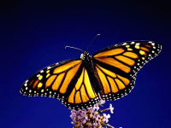
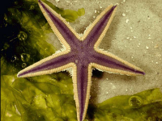
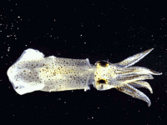
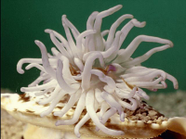
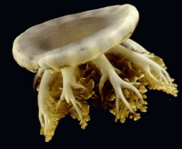
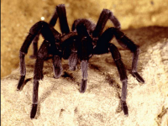
Invertebrates
Animals without a backbone.

Slide 5
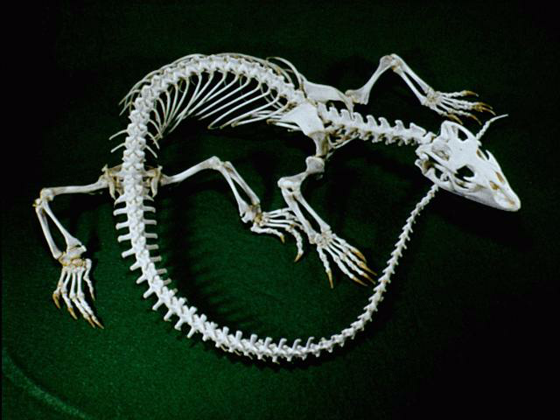
Vertebrates
Animals with a backbone.

Slide 6
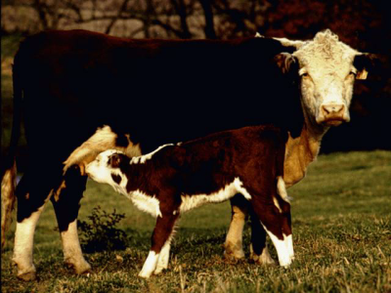
Mammals
Give birth to live young.
Feed their babies with their own milk.
Are more or less covered with hair.
Are warm-blooded.

Slide 7
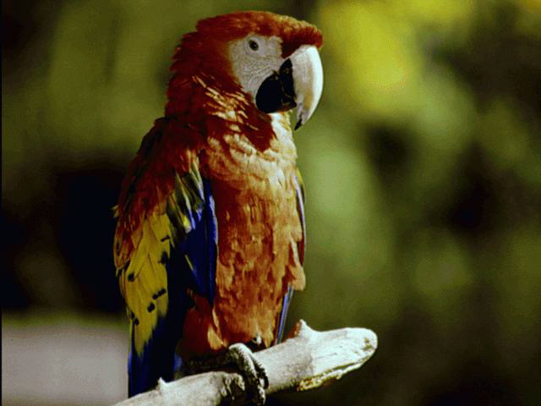
Birds
Have feathers.
Lay eggs.
Are warm-blooded.

Slide 8
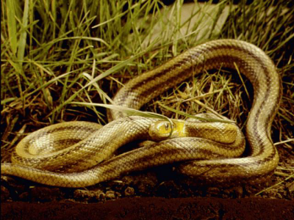
Reptiles
Are cold-blooded.
Lay eggs.
Have a dry skin covered with scales.

Slide 9
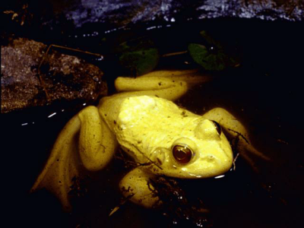
Amphibians
Are cold-blooded.
Lay eggs.
Have a smooth, moist skin.
Are able to live on land as well as in the water.

Slide 10
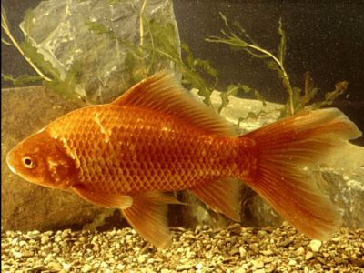
Fish
Are cold-blooded.
Lay eggs (but some do give birth to live young).
Have a moist skin covered in scales.
Breathe through gills.

Slide 11
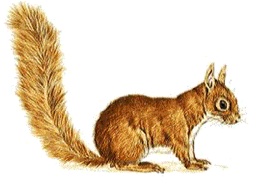
What am I?
Mammal, Bird, Fish, Amphibian or Reptile?
I am a mammal. My body is warm and furry. I feed my babies on milk. I give birth to live young.

Slide 12
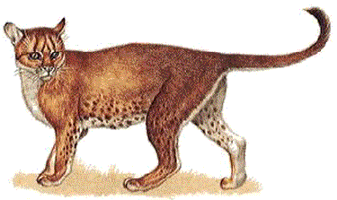
What am I?
Mammal, Bird, Fish, Amphibian or Reptile?
I am a mammal. My body is covered in hair, or fur. I feed my babies on milk. I give birth to live young.

Slide 13
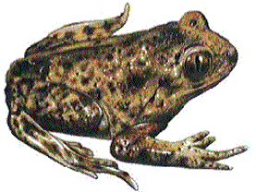
What am I?
Mammal, Bird, Fish, Amphibian or Reptile?
I am an amphibian. My body is moist and smooth. I lay eggs. I like to live in or near to water.

Slide 14
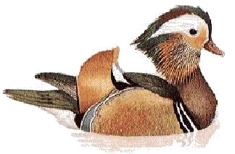
What am I?
Mammal, Bird, Fish, Amphibian or Reptile?
I am a bird. My body is warm and covered with feathers. I lay eggs which hatch out into chicks.

Slide 15
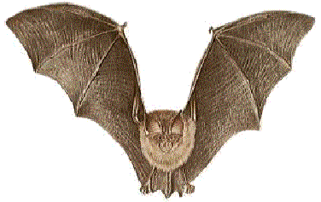
What am I?
Mammal, Bird, Fish, Amphibian or Reptile?
Although I have wings, I am in fact a mammal. My body is covered in hair, not feathers. I feed my babies on milk. I do not lay eggs.

Slide 16
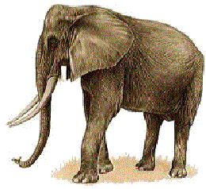
What am I?
Mammal, Bird, Fish, Amphibian or Reptile?
I am a mammal. If you stand very close to me, you will see I have hairs on my body. I feed my babies on milk. I do not lay eggs.

Slide 17
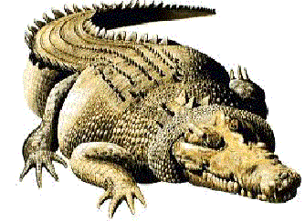
What am I?
Mammal, Bird, Fish, Amphibian or Reptile?
I am a reptile. My body is covered in dry scales. I lay eggs.

Slide 18
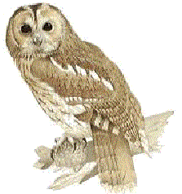
What am I?
Mammal, Bird, Fish, Amphibian or Reptile?
I am a bird. My body is warm and covered with feathers. I lay eggs which hatch out into chicks.

Slide 19
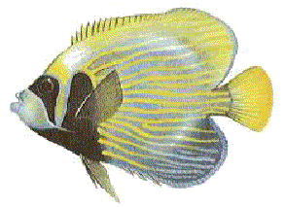
What am I?
Mammal, Bird, Fish, Amphibian or Reptile?
I am a fish. My body is cold to touch and is covered in scales. I lay eggs. I use gills to breathe with under water.

Slide 20
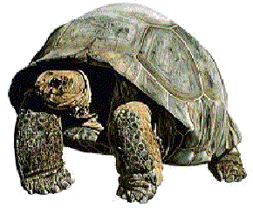
What am I?
Mammal, Bird, Fish, Amphibian or Reptile?
I am a reptile. My body is covered in dry scales. I lay eggs.

Slide 21
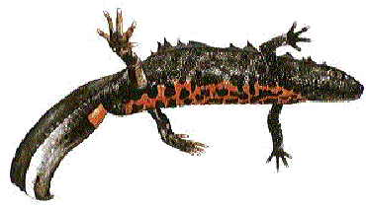
What am I?
Mammal, Bird, Fish, Amphibian or Reptile?
I am an amphibian. My body is moist and smooth. I lay eggs. I like to live in or near to water.

Slide 22
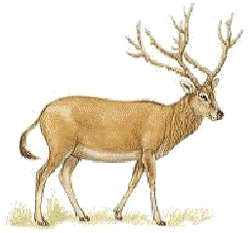
What am I?
Mammal, Bird, Fish, Amphibian or Reptile?
I am a mammal. My body is warm and furry. I feed my babies on milk. I give birth to live young.

Slide 23
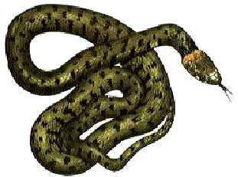
What am I?
Mammal, Bird, Fish, Amphibian or Reptile?
I am a reptile. My body is covered in dry scales. I lay eggs.

Slide 24
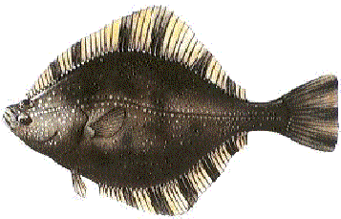
What am I?
Mammal, Bird, Fish, Amphibian or Reptile?
I am a fish. My body is cold to touch and is covered in scales. I lay eggs. I use gills to breathe with under water.

